Slide 1
Managing Your Departmental Funds
In Banner
Presented by:
Office of University Budget
Nicole Bowman & Beckie Cooper

Slide 2
Finance Terms
You Need To Know
  Adopted Budget* = Entered during Budget Cycle
  Budget Adjustment* = Budget Transfers/Revisions
  Adjusted Budget** = Adopted Budget plus Adjustments
  Year to Date* = Actual Expenses/Receipts
  Encumbrances* = Future Commitments of Funds
  Available Balance = Uncommitted Funds
  *Will be able to drill down to detail **Only option in Banner 9

Slide 3
Account Codes
  50**** - Revenue
  60**** - Labor
  700*** - Budget Pool
  70**** - Maintenance
  811*** - Transfers (Includes 811970, 811991, 811992, 811993, 811994, etc. Will be reflected at bottom of fund.)
  % (percent sign) is the Banner “Wild Card”

Slide 4
Maintenance Budget Pools
Note: Not used on Grants

Slide 5
How do I get access to Banner?

Slide 6
Banner Access Request
To request access to Banner Administrative (Banner 9), Self Service, COGNOS report tools, or ePrint repositories, go to:
https://apps.okstate.edu/access_request/index.php

Slide 7
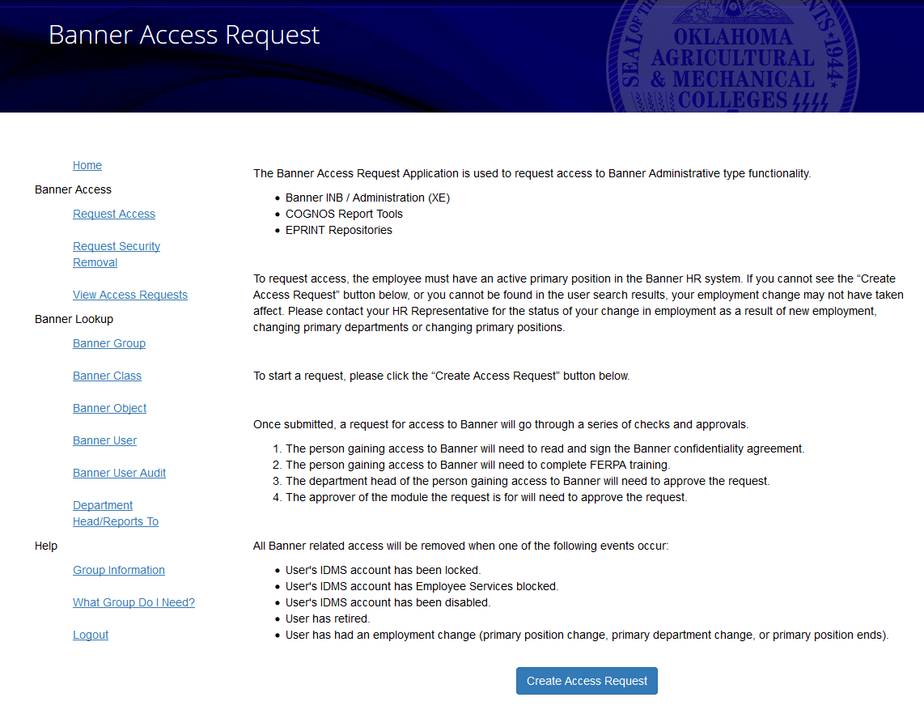

Slide 8
Banner Access Request
Common access needed:
  Finance
    Finance General Access for all users of Finance
    Finance Grants Query
    Finance General Query EOY Group
    Payroll Expense Detail
  HR
    HR Departmental Query
    HR General Query All Operators
    Finance Payroll Reports
    EPRINT OSU Reports for General Banner HR Users

Slide 9
Self Service Banner
(SSB)

Slide 10
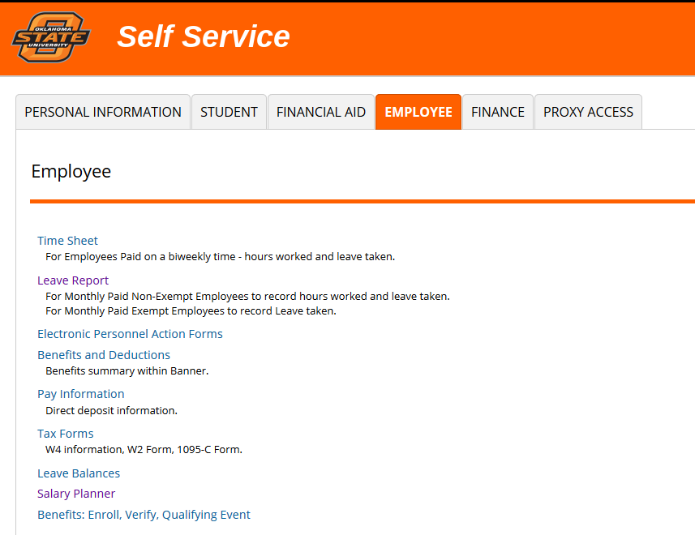

Slide 11
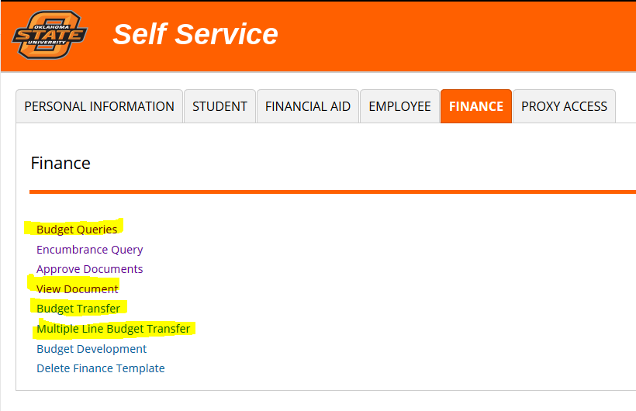

Slide 12
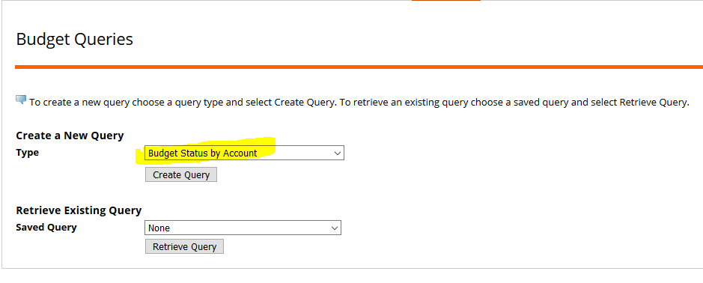
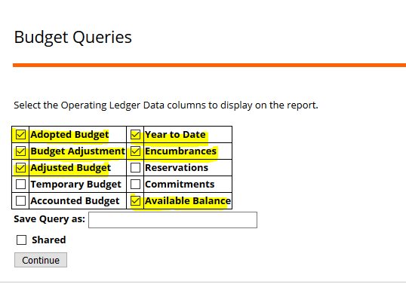
Budget Queries in
Self Service Banner

Slide 13
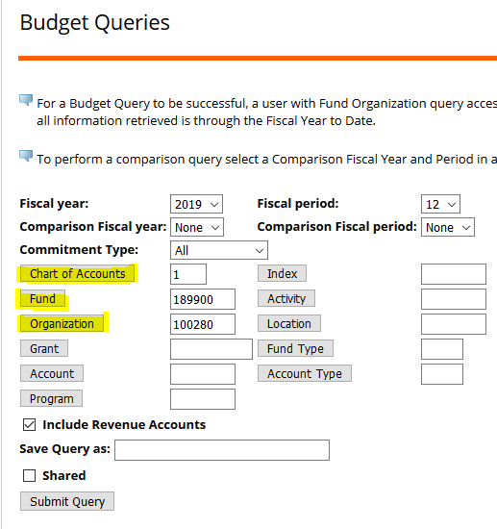
Budget Queries in
Self Service Banner
  To query a fund, you will need to know:
    Chart - Fund - Organization
  Use fiscal period “12” for cumulative expense information
  You can use the Wild Card on this screen

Slide 14
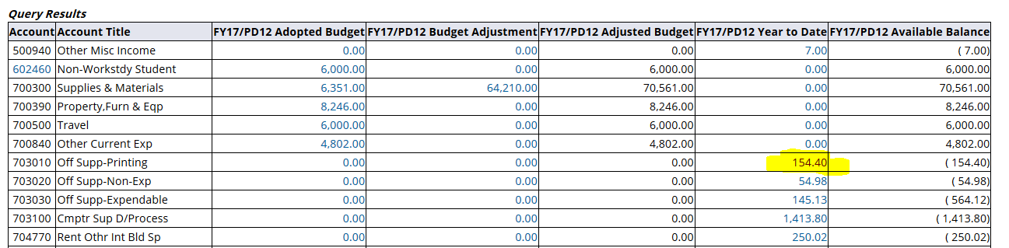
Query Output
  If a number is blue, you can drill down to see the detail on what makes up that number.

Slide 15
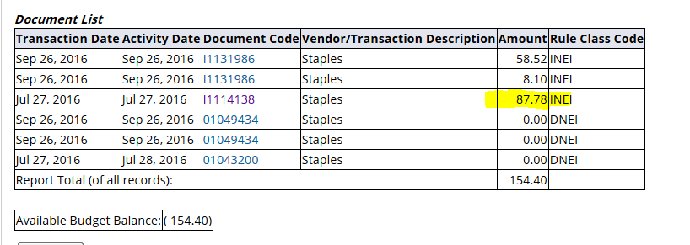
Drill Down Screens

Slide 16
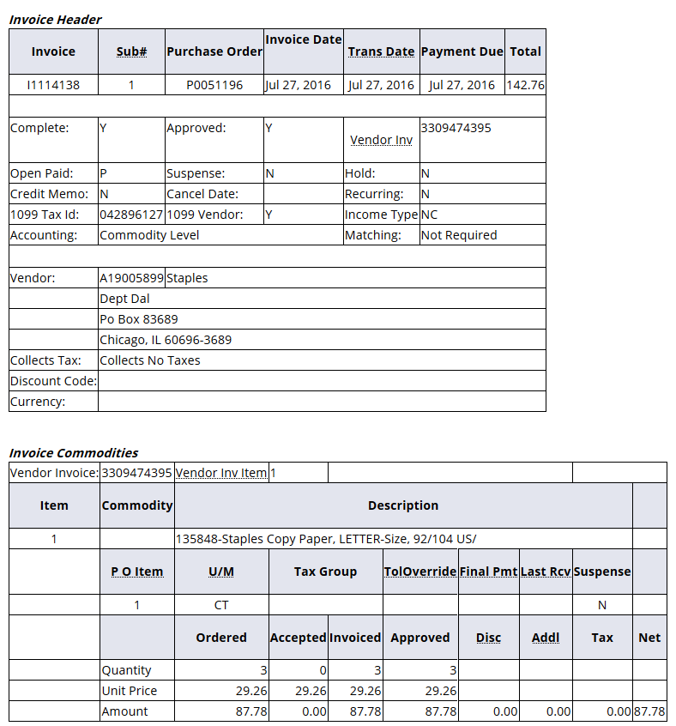
Drill Down Screens

Slide 17
Changes to Available Balance
  Available Balance will have to be manually calculated in SSB
  Maintenance accounts are budgeted within the Budget Pools in non-grant funds
  Maintenance expenses will hit the specific expense accounts
  Budget Pool – Actual Expenses – Encumbrances = Available Balance

Slide 18
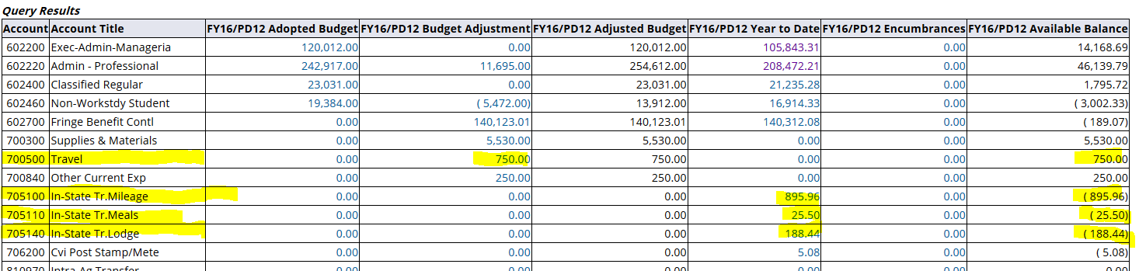
Available Balance Calculation
Travel Available Balance = ($359.90)
On this fund, a solution could be to do a BT1 to move funds from 700300 pool to the 700500 pool to cover the deficit and fund 700500 for the amount needed.

Slide 19
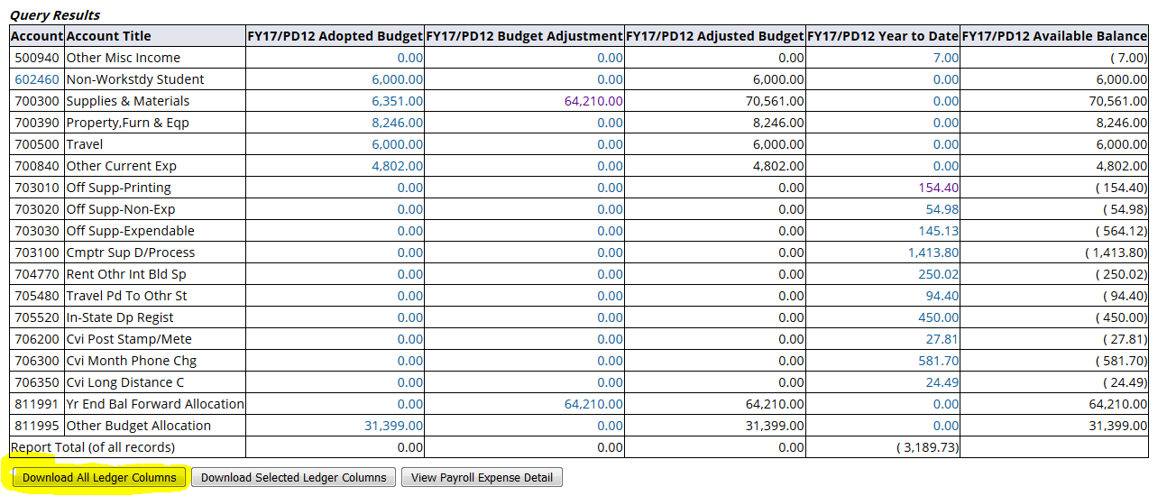
Available Balance Calculation
If several lines within a pool are in use, it might be easier to download the spreadsheet, sort and find the Available Balance that way.

Slide 20
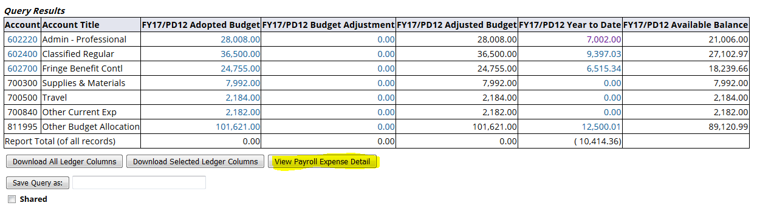
View Payroll Expense Detail
  This button will give you detail for what makes up the Year to Date payroll numbers

Slide 21
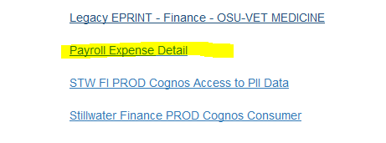
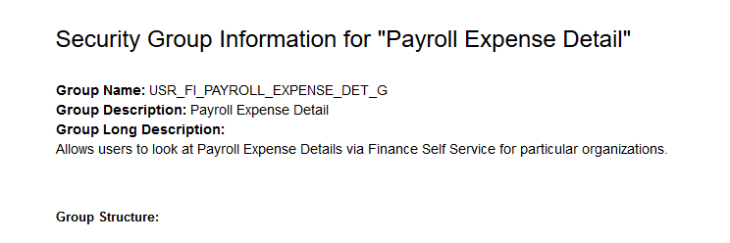
View Payroll Expense Detail
  Access can be requested through the Banner Access Request site.

Slide 22
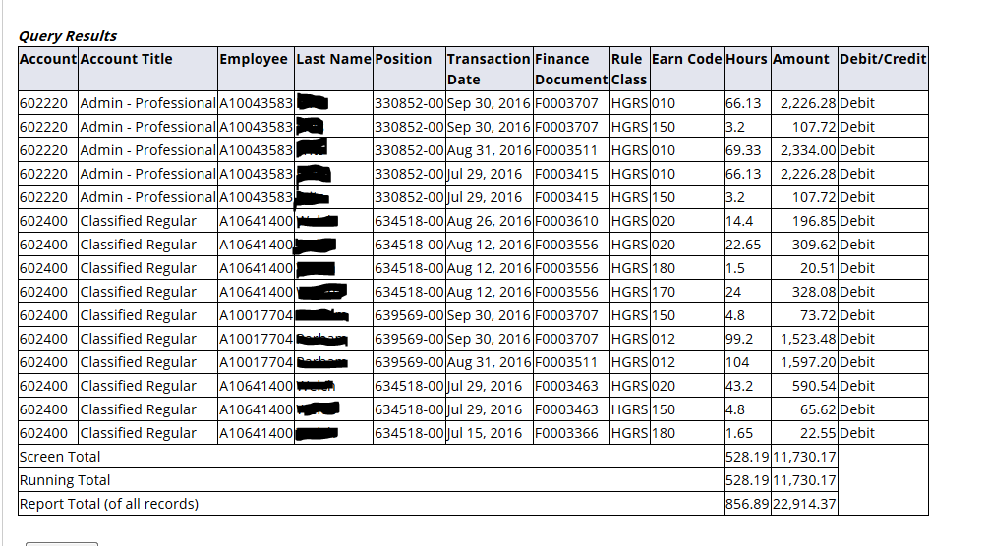
View Payroll Expense Detail

Slide 23
Carryforward Account Code
  819999 – This is an ADJUSTMENT to the General Ledger balance and should not be factored in when you are looking at revenues in your fund.
  811991 – This is the account that you will use and follow to know what you have to spend in Carryforward funds. This is in the Operating Ledger.

Slide 24
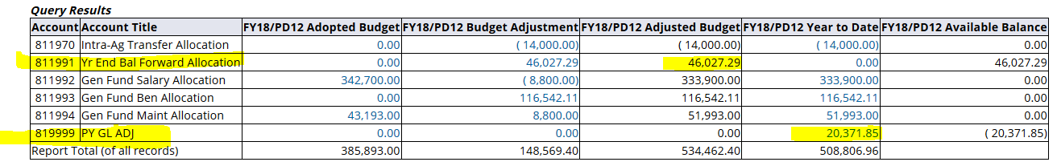
Carryforward Account Code
  This shows $20,371.85 being added to GL balance on 819999. However, the CF being recognized is $46,027.29 on 811991.
  Ignore the $20k for Operating Ledger/spending purposes.

Slide 25
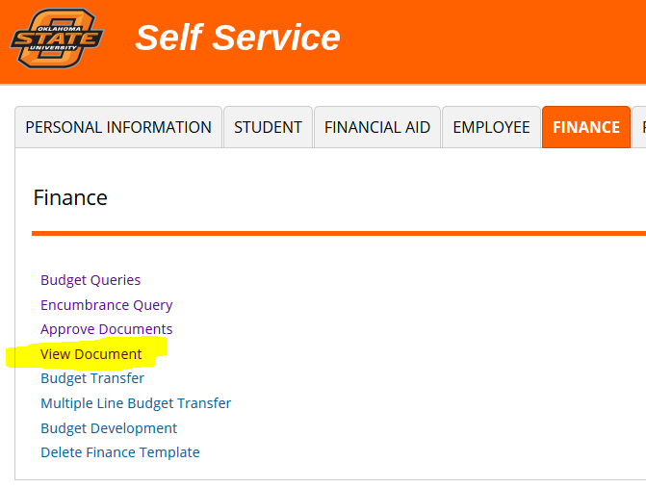
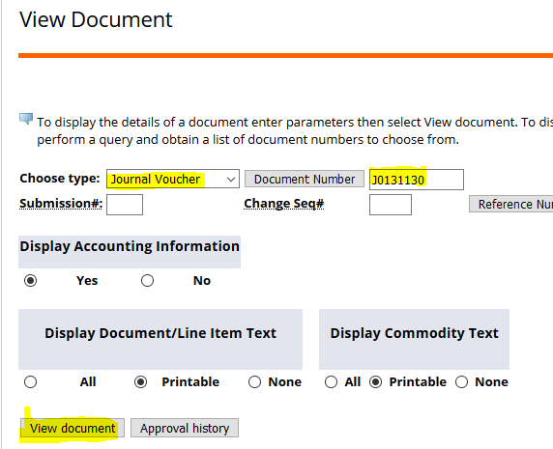
View Document

Slide 26
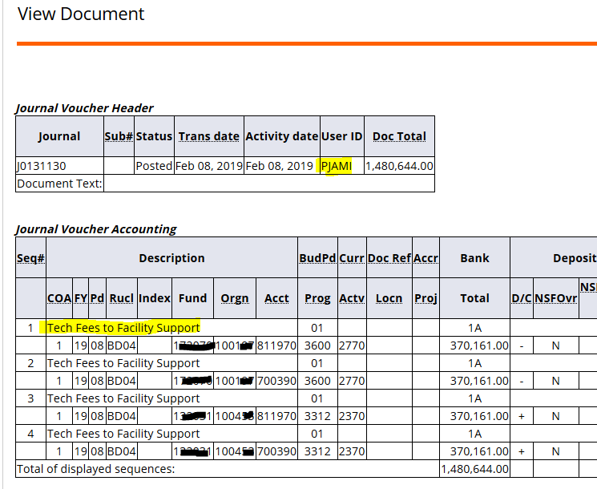
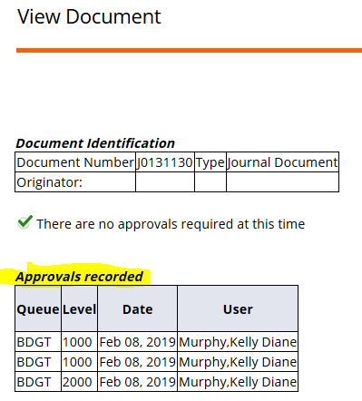
View Document
  *You can also view the Approval History

Slide 27
Budget Transfers
  All increases to Budgets are a plus (+)
  All decreases to Budgets are a minus (-)
  This is on BOTH sides of the entry
  When dealing with cash, debits and credits will still apply

Slide 28
Budget Transfers
  SSB only handles offsetting entries with both a “+” and “ – “
  SSB will only process transfers between funds for which you have security clearance
  Budget Office will still have to key or approve:
    Budget revisions (via General Purpose Form)
    Transfers between colleges/areas outside of your control (via Budget Transfer Form)

Slide 29
Budget Transfers in
Self Service Banner
  Budget Transfer – for Reallocations (2 lines)
  Multiple Line Budget Transfer – for Transfers between funds or multiple line Reallocations (up to 5 lines)
  Budget Office will still have to key:
    Transfers when more than one budget pool is being moved

Slide 30
Budget Transfer Rule Codes for Self Service Banner
  BT1 – Move Budget between maintenance budget pools
  BT2 – Move Budget between labor expense accounts
  BT3 – Move Budget from one fund to another OR between salary & maintenance on non-allocated funds

Slide 31
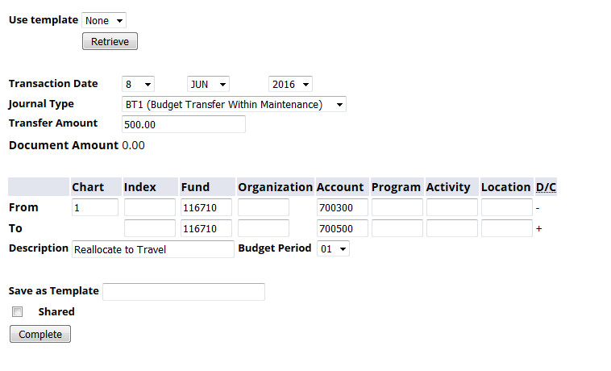
Budget Transfers

Slide 32
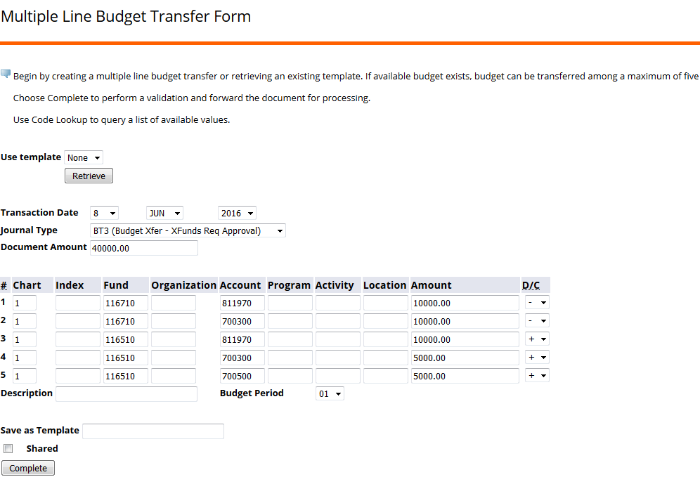
Multiple Line Budget Transfers

Slide 33
Banner Administrative
(Banner 9)

Slide 34
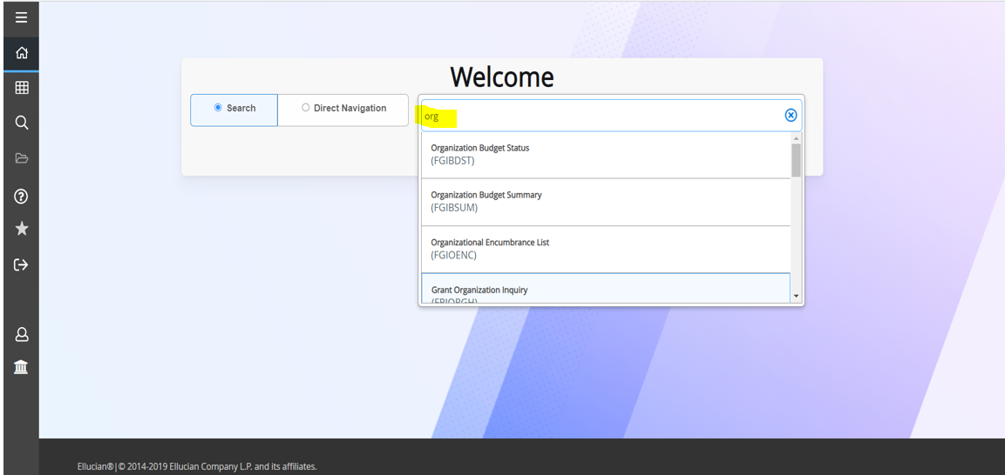
Search for a page by entering a keyword (shown above) or the actual form name.

Slide 35
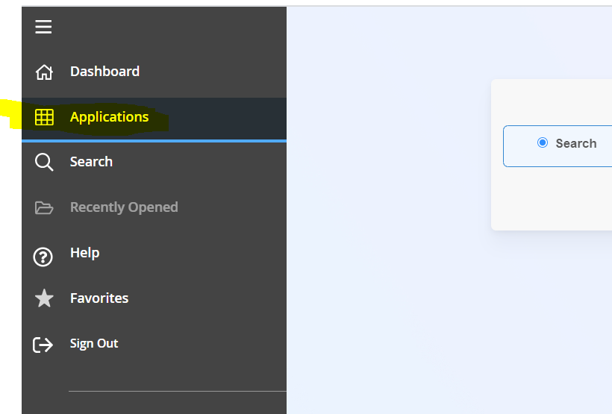
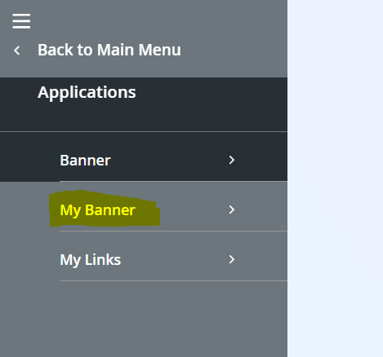
My Banner
My Banner can be found under Applications.

Slide 36
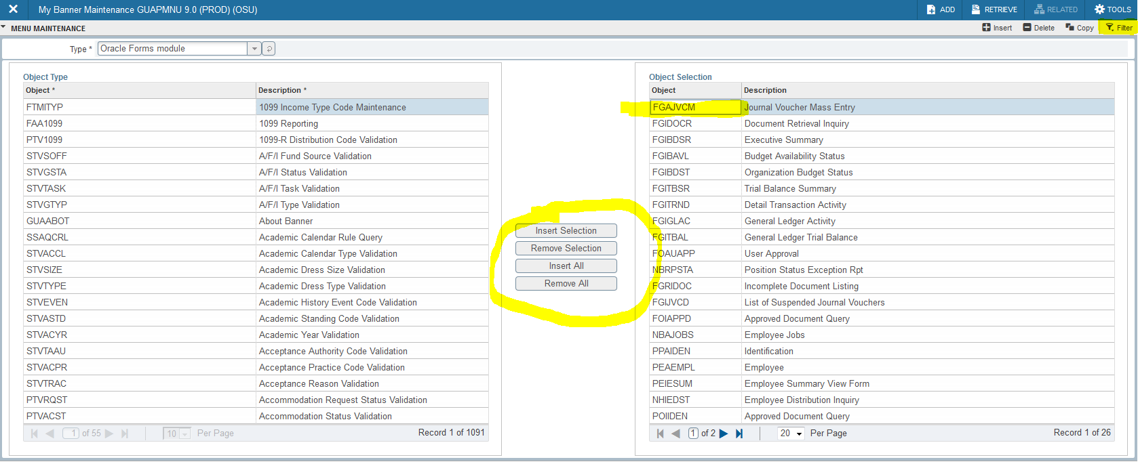
GUAPMNU
My Banner Maintenance
This is the screen used to set up My Banner. You can enter the page name in the My Banner side. Or you can search all pages on the left and add it using the Insert Selection button.

Slide 37
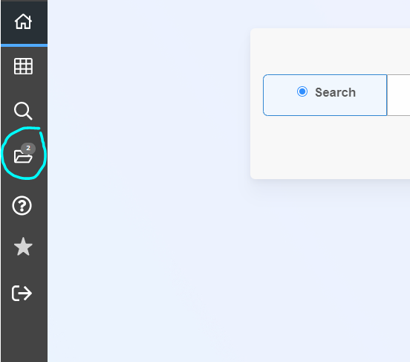
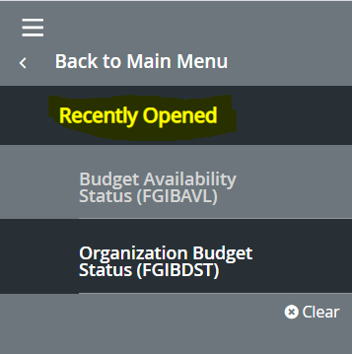
Recently Opened Pages
The Recently Opened folder will show all pages opened during the current session.

Slide 38
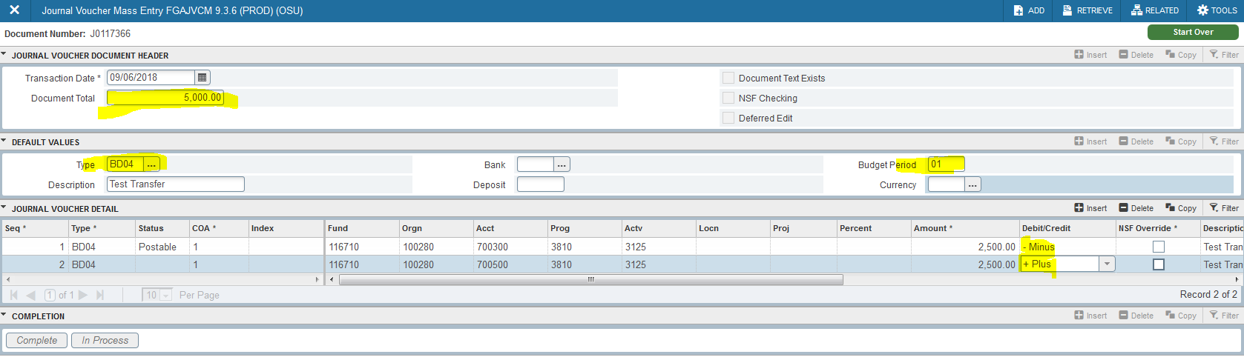
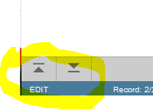
FGAJVCM
Journal Voucher Mass Entry
Once the Default Values section is complete, use the down arrow at the bottom left of the page to get into the Journal Voucher Detail. And again to get to the Complete/In Process buttons.
These arrows take place of your Cntl/Pg Down (Next Block)

Slide 39
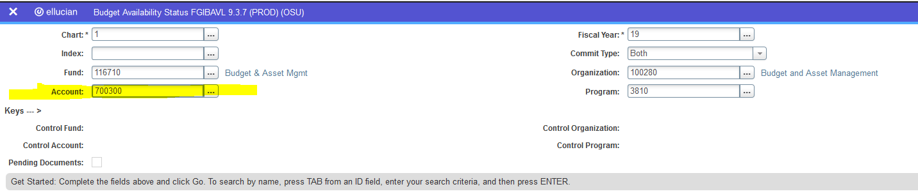
FGIBAVL
Budget Availability Status
  To get output on FGIBAVL, you will need to enter the first Budget Pool you want listed.
  It’s usually best to just enter 700300, which will include 700300 through 700840.

Slide 40
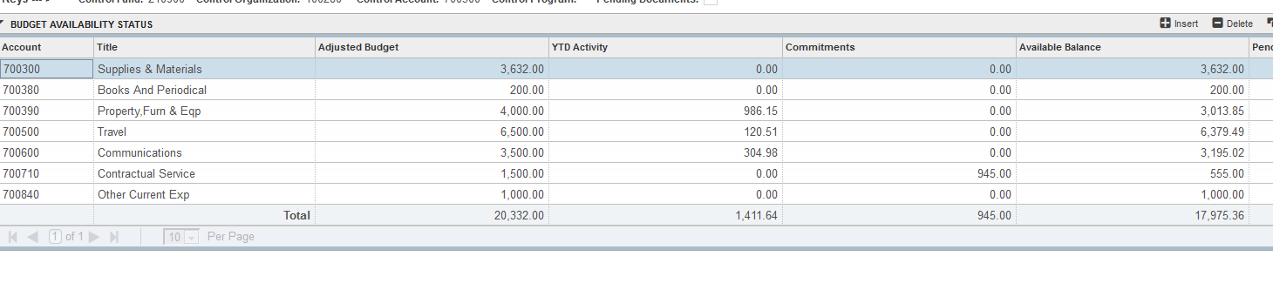
FGIBAVL
Budget Availability Status
  Will show current Available Balance for each Budget Pool (have to manually calculate in SSB).
  This is the amount being read by OkCorral and other ‘budget check’ processes.

Slide 41
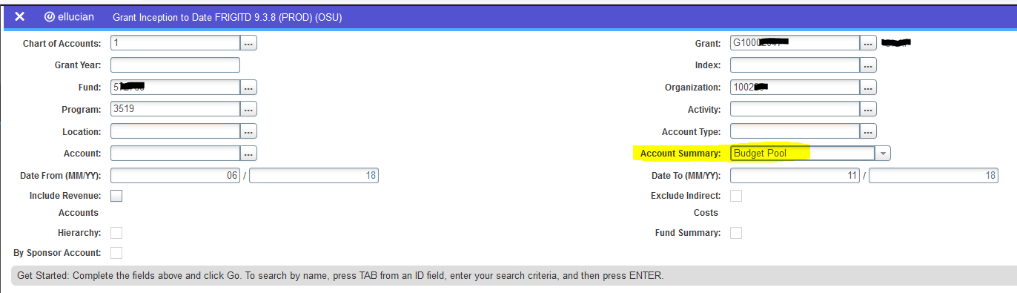
FRIGITD
Grant Inception to Date
  If you have a grant fund that is not passing a budget check, this is the grant-version of FGIBAVL.
  The main thing to remember on this page is to select Budget Pool under the Account Summary.

Slide 42
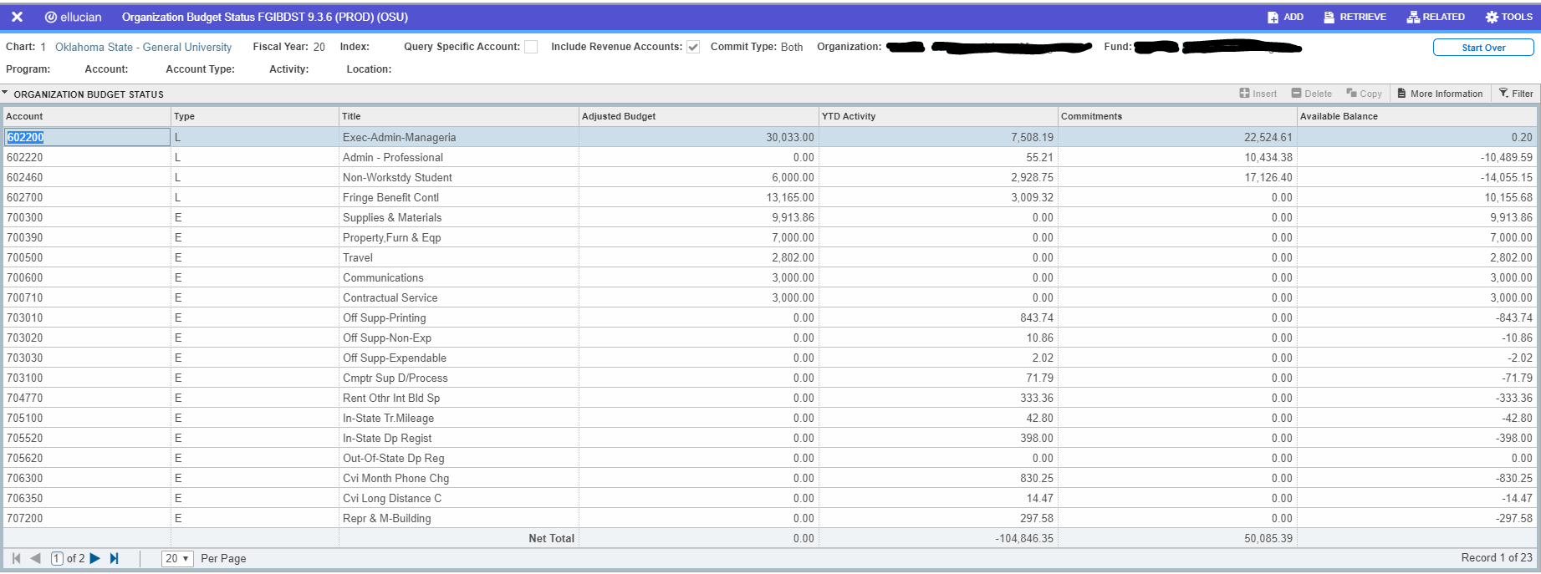
FGIBDST
Organization Budget Status

Slide 43
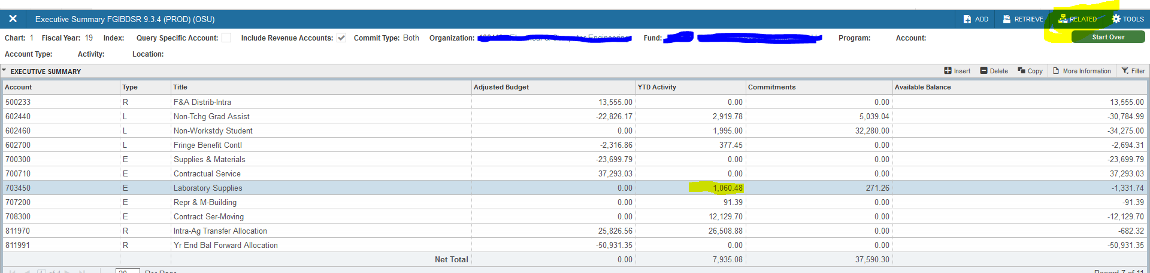
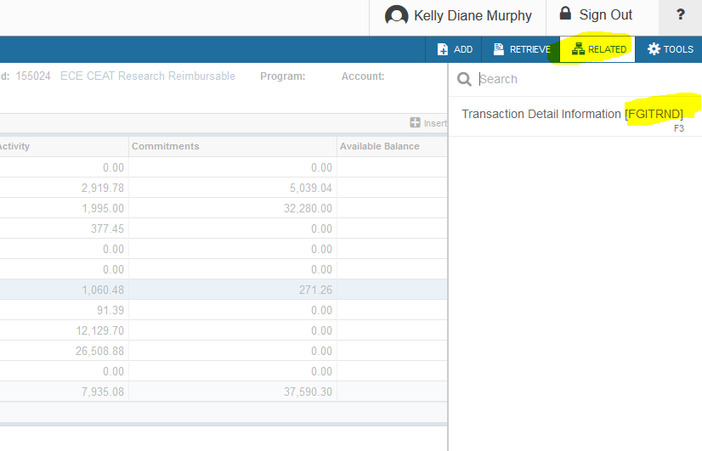
FGIBDSR
Executive Summary
  To get detail on a transaction, go to RELATED….and select FGITRND
  You will see all of the individual transactions making up that total. You will have option to drill down further.

Slide 44
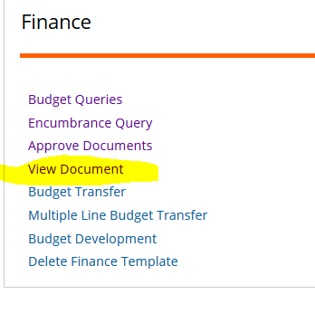
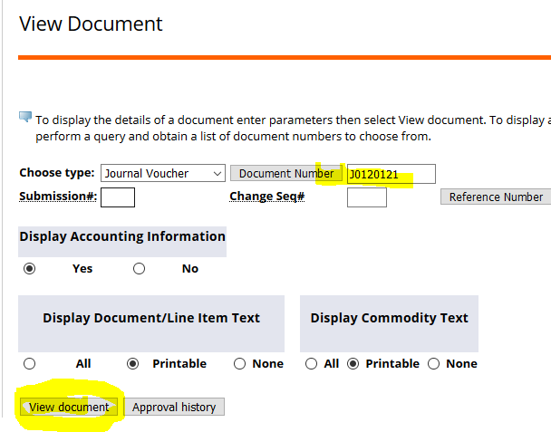
FGIDOCR
Document Retrieval Inquiry
  Enter the Document number and it will display the transaction detail.
  This can also be done in SSB with the View Document link.

Slide 45
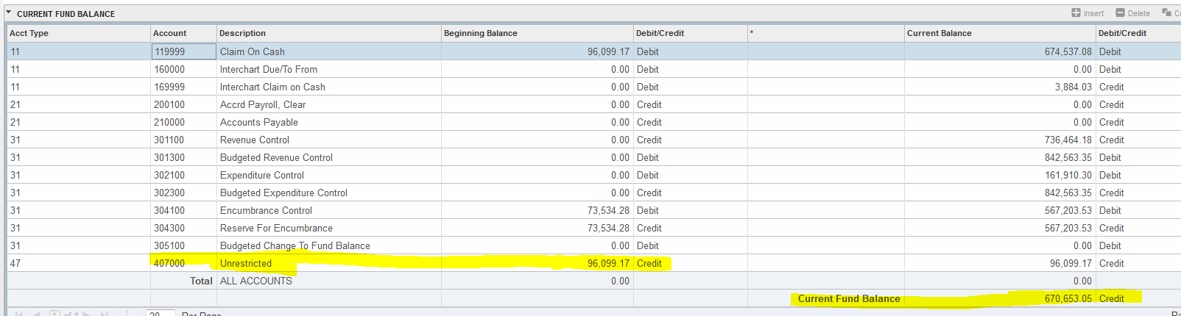
FGITBSR
Trial Balance Summary (GL)
  407000 line will show CF Balance from prior year. Credit is a positive CF Balance.
  Current Fund Balance is how much cash is in the fund at this point in time. Does not take into account encumbrances.

Slide 46
How do I reconcile a fund in Banner?

Slide 47
Reconciling Funds
ePrint Reports:
  FGRBDSC – Budget Status Report
  Summary of Revenue and Expenses for the period
  FGRFAAC – Fund/Account Activity Report
  General Ledger Summary
  Shows balance at end of period and carryforward
  FGRODTA – Organization Detail Activity
  Revenue and Expense detail for the period

Slide 48
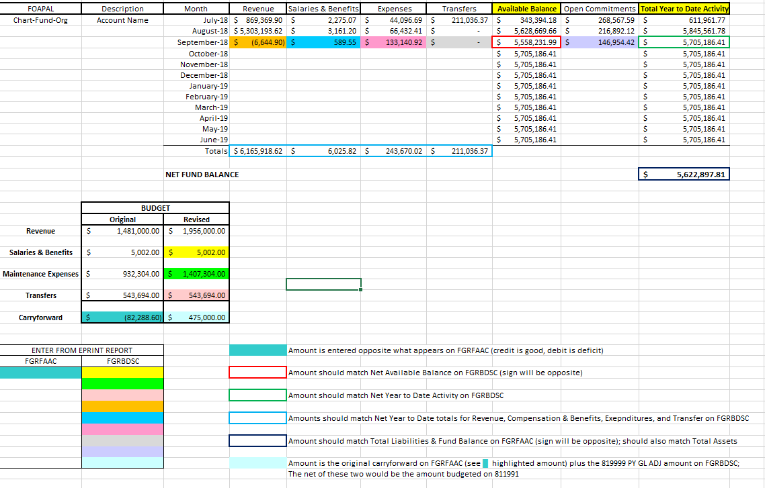
Fund Balance Worksheet

Slide 49
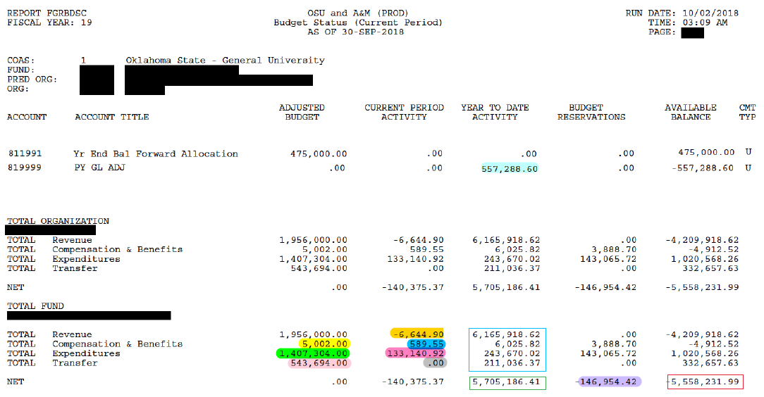
FGRBDSC
Budget Status Report

Slide 50
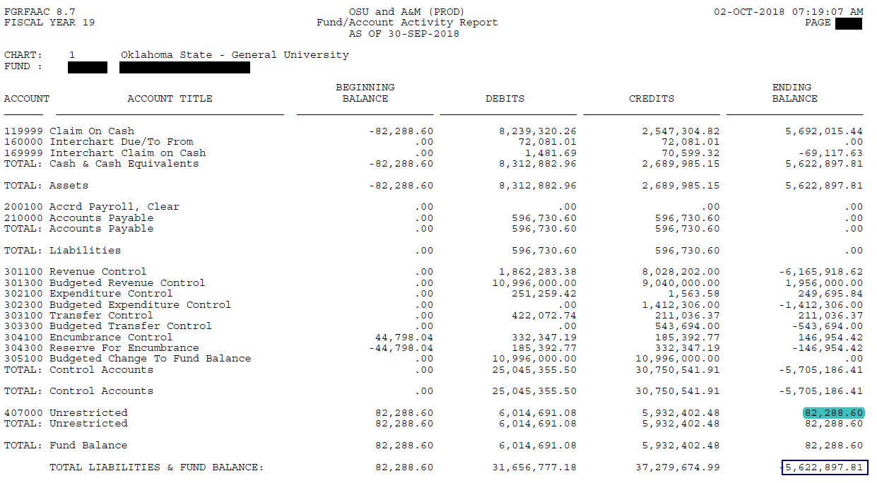
FGRFAAC
Fund/Account Activity Report

Slide 51
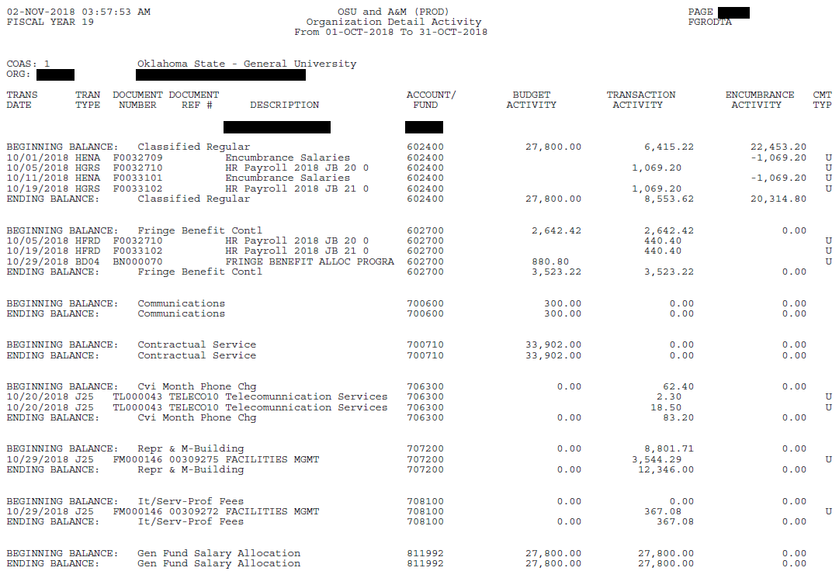
FGRODTA
Organization Detail Activity

Slide 52
Tips when Reconciling
The worksheet we have provided is a general guide that works as shown most of the time. There are always exceptions. For example, timing issues (i.e. payables posting the last day of the month) may also need to be figured in when balancing to the FGRFAAC report.
To project how much cash you have available, you will also need to account for anticipated charges not encumbered in Banner, like fringe benefits or monthly phone bill.

Slide 53
For Questions or Budget Transfer submissions, please email:
sysbdgt@okstate.edu
For Forms and other information, visit our webpage:
adminfinance.okstate.edu/budget

