Slide 1
Cash Handling, Deposit Requirements & Reconciliation Guidelines
Presented by:
Office of Bursar: Laurie Beets
University Accounting: Rita Hesser

Slide 2
Mandatory Training
This training is essential for ensuring compliance and proper financial procedures across all departments, especially with 3-0331.
Internal Audit may include a review of cash handling procedures, practices, and reconciliations in departmental audits.

Slide 3
Mandatory Training
Attendance records are documented
Email Susan Sharpton susan.sharpton@okstate.edu
  Please include one take away
  Use the email for documentation of attendance

Slide 4

Agenda
  Cash Handling
  Departmental Deposits
  Reconciliation
  Banner Access
  Resources
  Q&A

Slide 5
Cash Handling
  Definition
  * University funds are monies received from tuition, contracts and grants, delivery of revenues from University services, state and federal appropriations, gifts and all other sources of revenue or expense reimbursements, whether restricted or unrestricted as to purpose or use.
  * All checks made payable to the University or any subdivision of the University are considered University funds.
  * Cash includes currency, checks, money orders, wires, electronic funds, web checks, negotiable instruments, and credit card transactions.

Slide 6
Cash Handling
  Protecting Cash
Departments accepting cash, checks, or credit cards must provide for adequate safekeeping of the funds and maintain documented internal control policies.
All forms of Cash (currency, checks, money orders, and credit card transactions) must be physically protected through the use of vaults, locked cash drawers, cash registers, locked money bags, or locked metal boxes etc.
It is each department’s responsibility to make whatever provisions necessary to properly safeguard the cash in their area.
Cash should never be retained in desk drawers or standard file cabinets since they are easily accessed with minimal forcing or readily available keys.
Access should be limited.

Slide 7
Collecting Cash Guidelines
Receipt immediately on sequentially prenumbered receipts or through a point-of sale register
Provide a receipt to the customer
Restrictively endorse checks immediately
Checks are payable to the University/Department; never to an individual
Do not accept post dated (future dated) checks
Maintain check logs (Resource slide- example)
No foreign currency is ever accepted

Slide 8
Collecting Cash Guidelines
OSU requires employees handling/access/accounting for cash transactions to take at least 5 continuous days (to be taken at one time) of leave each year.
Segregation of duties: Different people should be responsible for receiving, recording, depositing, and reconciling cash.

Slide 9
Departmental Deposits
  Deposit timing requirement- Policy 3-0331:
  All collections received shall be promptly deposited with the OSU Bursar Office into a properly designated account on the same banking day as received. (Title 62, Oklahoma State Statutes, Section 34.57). If collections are received during a weekend or holiday, the monies will be kept in a secured environment and must be deposited with the OSU Office of Bursar on the ensuing working day.
If your department receives cash daily:
Establish a cutoff time for processing receipts.
Process all receipts received prior to the cutoff time and deliver the departmental deposit to the Bursar Office teller prior to 4pm.
Items received after the cutoff time are included in the next day’s deposit.

Slide 10
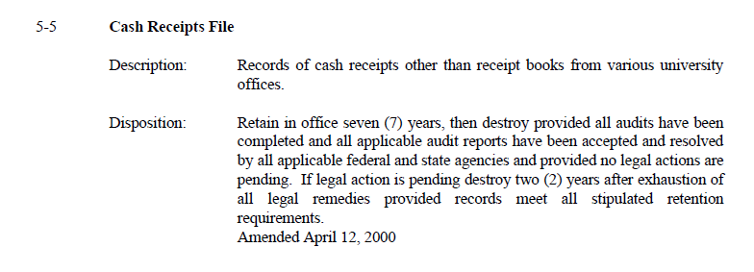
Departmental Deposits
  Record Retention: Edmon Low Library/Records Management: https://archives.library.okstate.edu/archives/records-management

Slide 11
Departmental Deposits
  Checks
Restrictively endorsed “For Deposit Only”. Include department name, finance fund/account number
Provide two adding machine tapes totals (from written line)

Slide 12
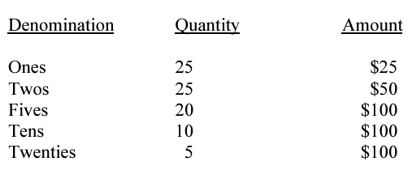


Departmental Deposits
  Cash
  Bills should be face up in same direction.
  Bundle and paper clip bills:
  Coin rollers may be obtained from Bursar Office. Write department’s name on each roll.

Slide 13
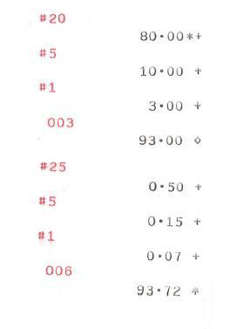
Departmental Deposits
  Cash Include one adding machine tape listing each denomination (as shown here) and total cash in the deposit. Please do not add cash tapes and check tapes together.

Slide 14

Departmental Deposits
  Detailed AIRS procedures on the bursar website (see Resource slide)
Advantages to AIRS Deposits:
  Electronic archival of deposits
  Faster processing
  Fewer errors
  Ability to create deposit templates (as many finance funds/accounts as needed)
  Ability to search by receipt number, total deposit amount, or amount of tender within a deposit.

Slide 15
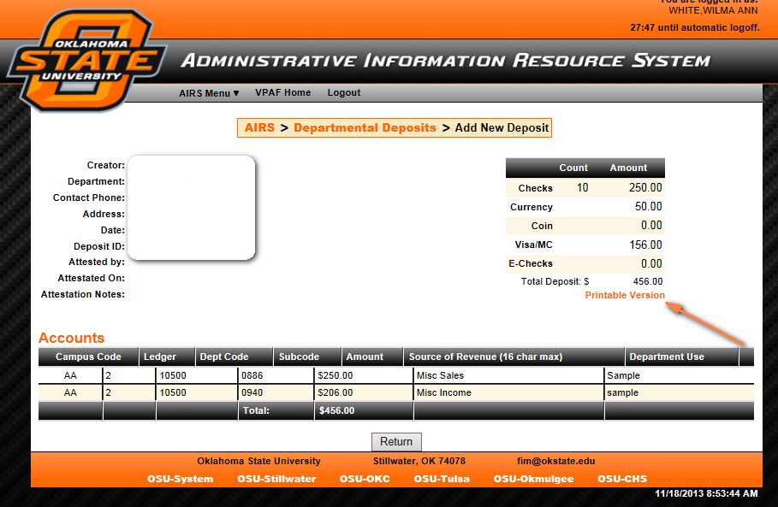
Departmental Deposits
  AIRS Things to Remember
  Debit entries are not allowed
  Bring one copy of the printable version
  While it is pending… it can be edited or deleted

Slide 16
Departmental Deposits
  Drop Off Depositing
  Purchase two locking bank bags through Bursar Office (Lisa Fry (alisa.fry@okstate.edu); approximately $25 per bag)
  Prepare the deposit and deliver to Bursar Office in a locked bank bag
  Empty bank bag picked up and signed for by the department, contains receipt

Slide 17
Reconciliation Guidelines
Reconciliation helps maintain financial integrity, accuracy, and reduces loss or theft.
Segregation of duties: Different people should be responsible for receiving, recording, depositing, and reconciling cash.
Internal audit may include a review of cash handling procedures, practices, and reconciliations in any departmental audit.

Slide 18
Reconciliation Guidelines
Collect all relevant documentation (cash register totals, credit card settlements, deposit receipts, and any other records of the transactions)
Verify amount(s) deposited/received matches the recorded transactions in Banner Finance
Ensures deposits are accounted for and discrepancies promptly identified
Regular reconciliation isn’t just about finding discrepancies, it’s about preventing them

Slide 19
How do I get access to Banner?

Slide 20
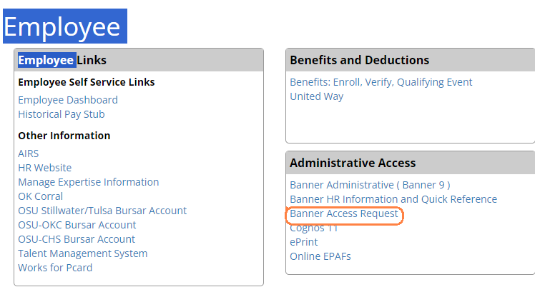
Banner Access Request
To request access to Banner Administrative (Banner 9), Self Service, COGNOS report tools, or ePrint repositories, go to:
https://apps.okstate.edu/access_request/index.php

Slide 21
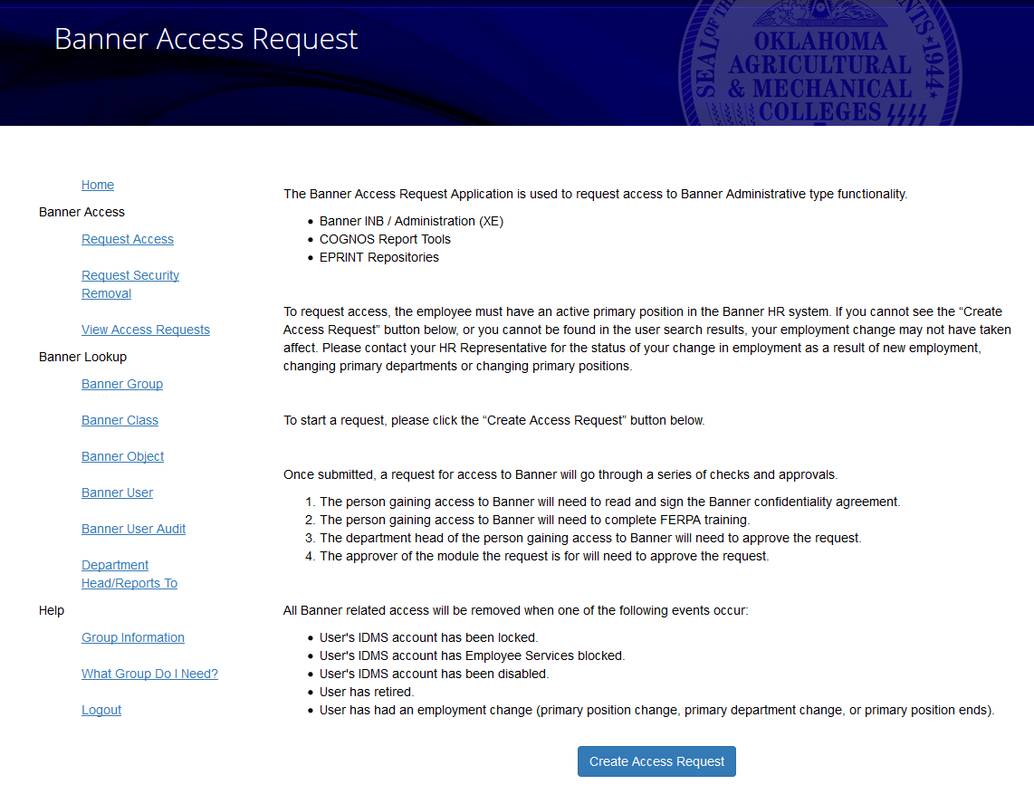

Slide 22
Banner Access Request
Common access needed:
  Finance
    Finance General Access for all users of Finance
    Finance Grants Query
    Finance General Query EOY Group
    Payroll Expense Detail
  General
    General Eprint Reports for OSU
  AR
    AR Staff and Campus Query
    AR Staff and Campus Maintenance

Slide 23
Self Service Banner
(SSB)

Slide 24
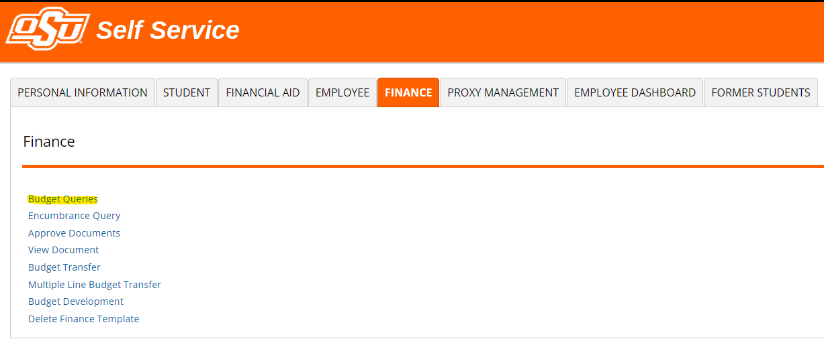

Slide 25
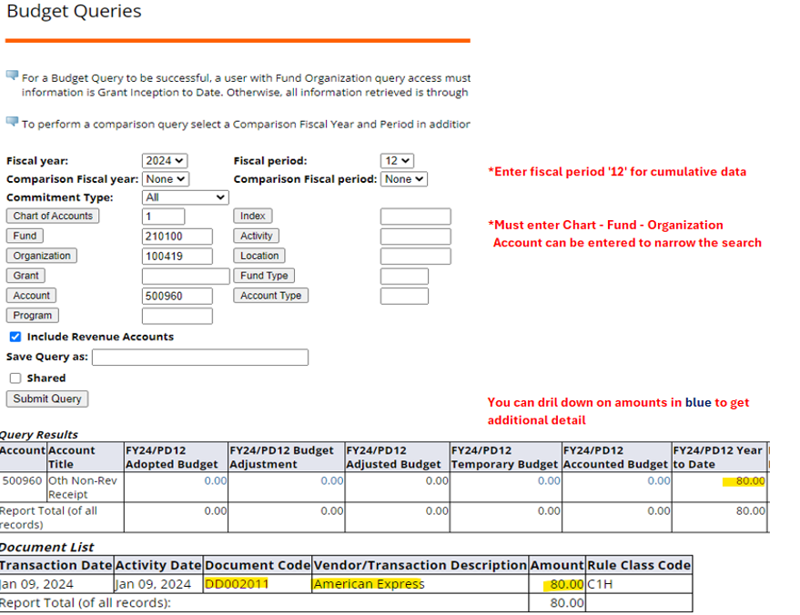

Slide 26
Banner Administrative
(Banner 9)

Slide 27
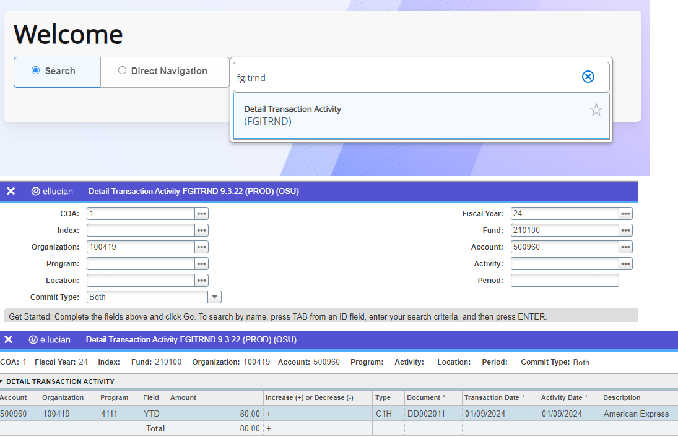
Search by entering a keyword or the actual name: FGITRND; enter: Fund, Account, Go; Hit Go again.

Slide 28

FGRODTA ePrint report Monthly Organization Detail Activity

Slide 29
Training Documents and
Procedures

Slide 30
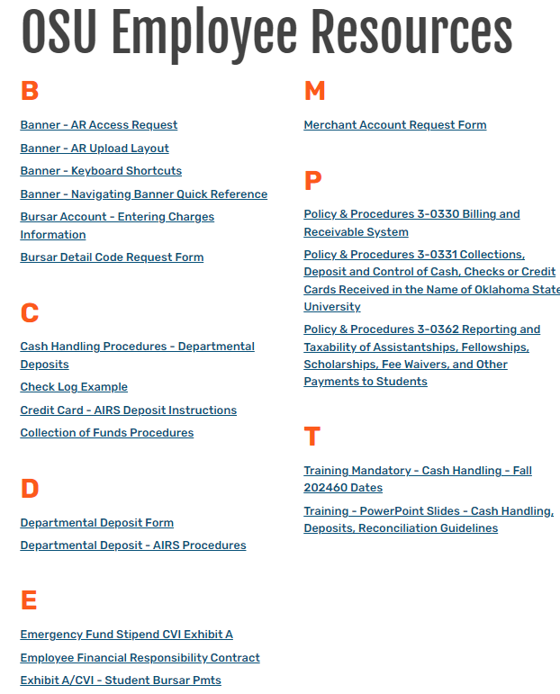
Resources
Bursar website
https://bursar.okstate.edu/forms_employees.html

Slide 31
??? QUESTIONS???
If you have questions, concerns or need help to address an unusual situation please contact your area’s Fiscal Officer or the Bursar’s Office at 405-744-5993, email bursar@okstate.edu

Slide 32
Reminder
Attendance records are documented
Email Susan Sharpton susan.sharpton@okstate.edu
  Please include one take away
  Use the email for documentation of attendance

