Slide 1
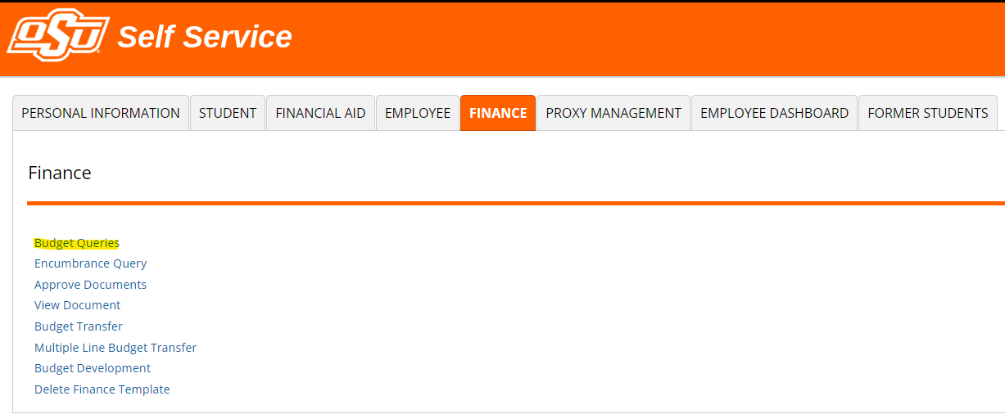
Self Service Banner (SSB)

Slide 2
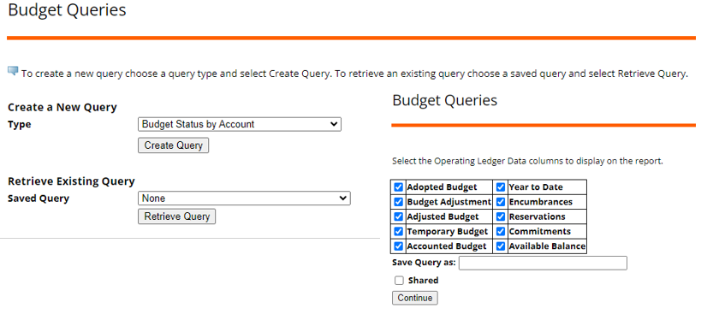
Budget Queries in Self Service Banner

Slide 3
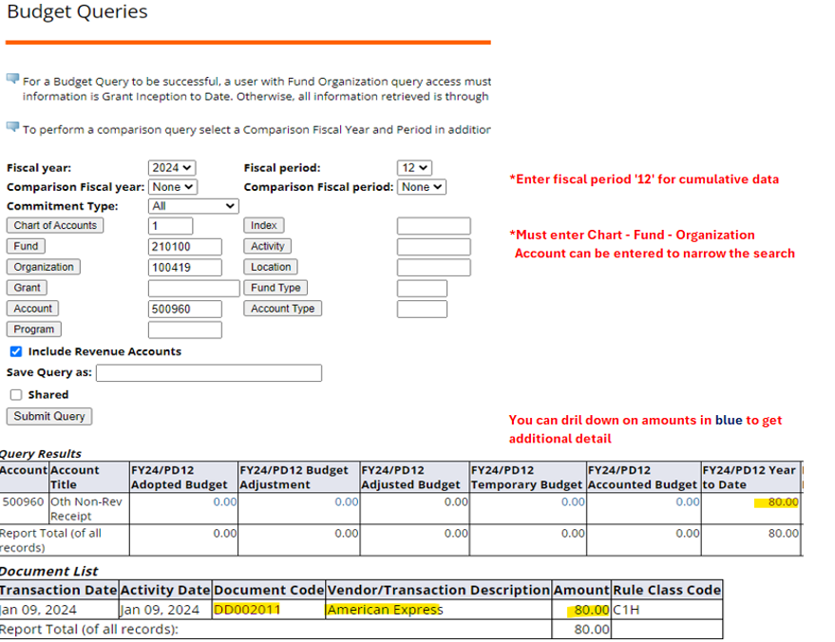

Slide 4
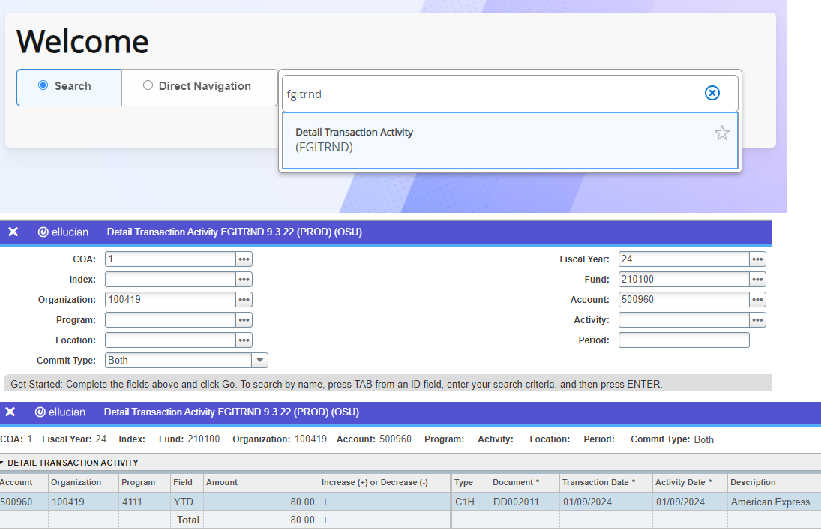
Banner Administrative (Banner 9)

